Slide 1
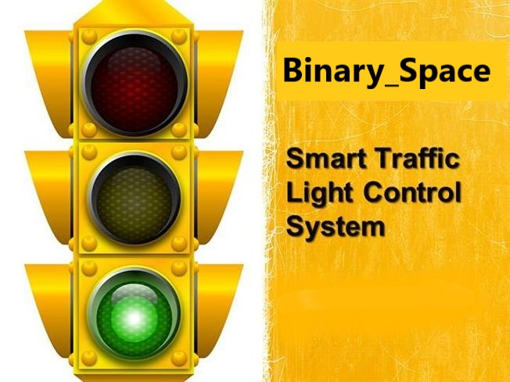

Slide 2
Smart Traffic Control System
Problem Statement : Our topic for hackathon is "Smart transportation & pollution control", we all have faced long traffic jams in our life, which are tiring as well as waste a plenty of time.
Team Name : Binary_Space
Team Number : STP130
Team Leader : Sainsh Sharma
Team Members : Jasmeet Singh, Ayushmaan Kapahi & Aastha Singh
Institution Name : Manav Rachna International Institute of Research and Studies

Slide 3
SOLUTION …
We are currently working on smart traffic control system using open-cv python in addition to Tkinter which helps to control the traffic at street intersections. Whether there currently exists one vehicle , two or just as many just as 100, this algorithm will work efficiently and will help us to create automated traffic control for the coming future.
This system will self rely on the road conditions and will automatically change the traffic lights to the best suited conditions.

Slide 4
What if we get thing right …
Emergency / Priority vehicle detection
Detect accidents and call for instant help

Slide 5
REQUIEMENT SPECIFICATION…
FUNCTIONAL REQUIREMENTS –
Functional requirements are those that refer to functionality of the system. That is what services it will provide to the users.
It provides the clear way for the ambulance to save the valuable lives of people.
Measurement of traffic density control.
Easy flow of traffic.
Greater efficiency of the system.

Slide 6
REQUIEMENT SPECIFICATION…
NON –FUNCTIONAL REQUIREMENTS
Non functional requirements are those that refer to the non –functionality of the system. That tells about how the system is benefit for the user. The different non –functional requirements are listed below:
Reliability : The system should be 99% reliable. Since it may need some maintenance or preparation for the some particular day, the system does not need to be reliable every time. So, 80% reliability is enough.
Efficiency : By changing the color of signal it will clear the way of traffic and priority vehicles if needed.
Availability : Camera and class classifier are always available any time.
Maintainability : The system should be optimized for supportability, or ease of maintenance as far as possible.

Slide 7
BASIC HARDWARE REQUIREMENTS
Processor : Pentium IV / ARDUINO OR ANY OTHER OPEN-SOURCE CHIPSET
Ram : 512 MB
SOFTWARE REQUIREMENTS
Operating System : Windows 7 and Above
Software Module : Open CV Image Processing.
Interfacing : Tkinter for Graphical user interface
Computer : A general purpose PC as a central processing unit for
various tasks

Slide 8
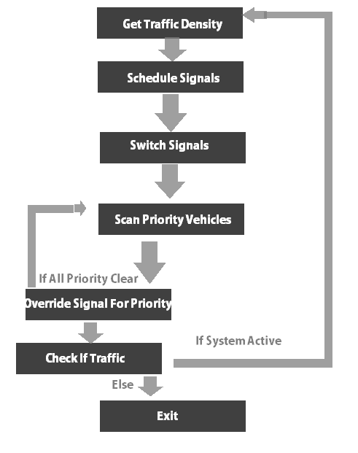
FLOW – CHART ( Traffic Control )

Slide 9
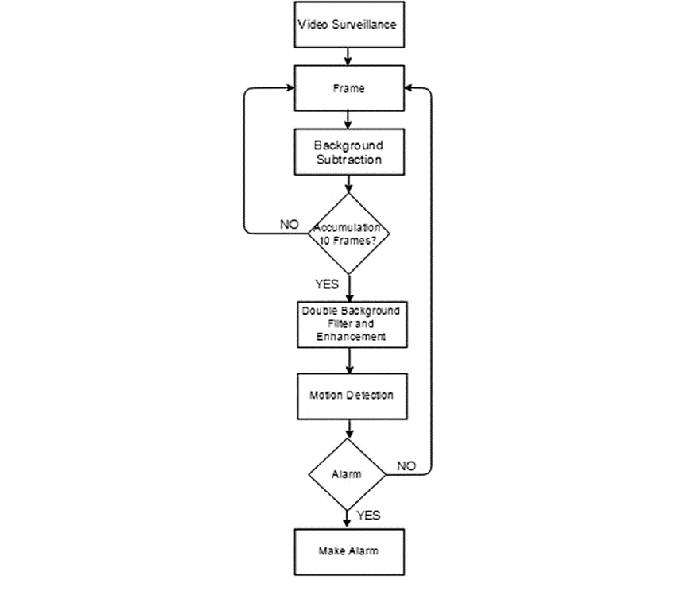
FLOW – CHART ( What our code says…. )

Slide 10
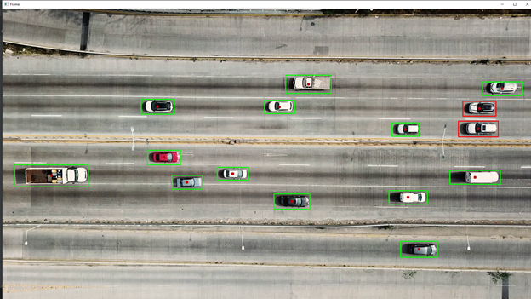
Vehicle Detection

Slide 11
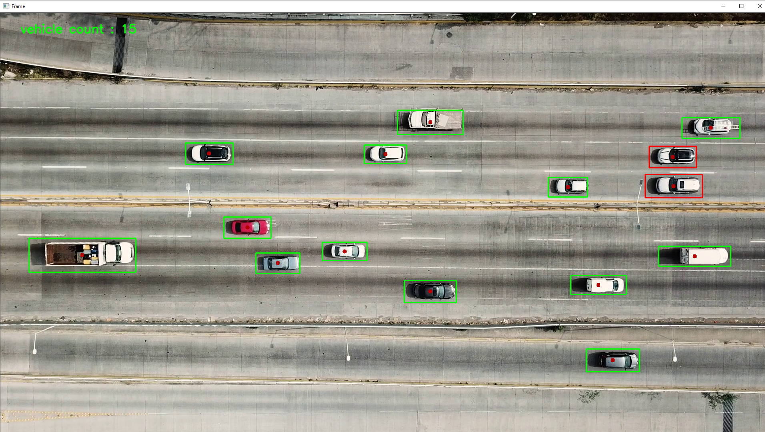
Vehicle Count

Slide 12
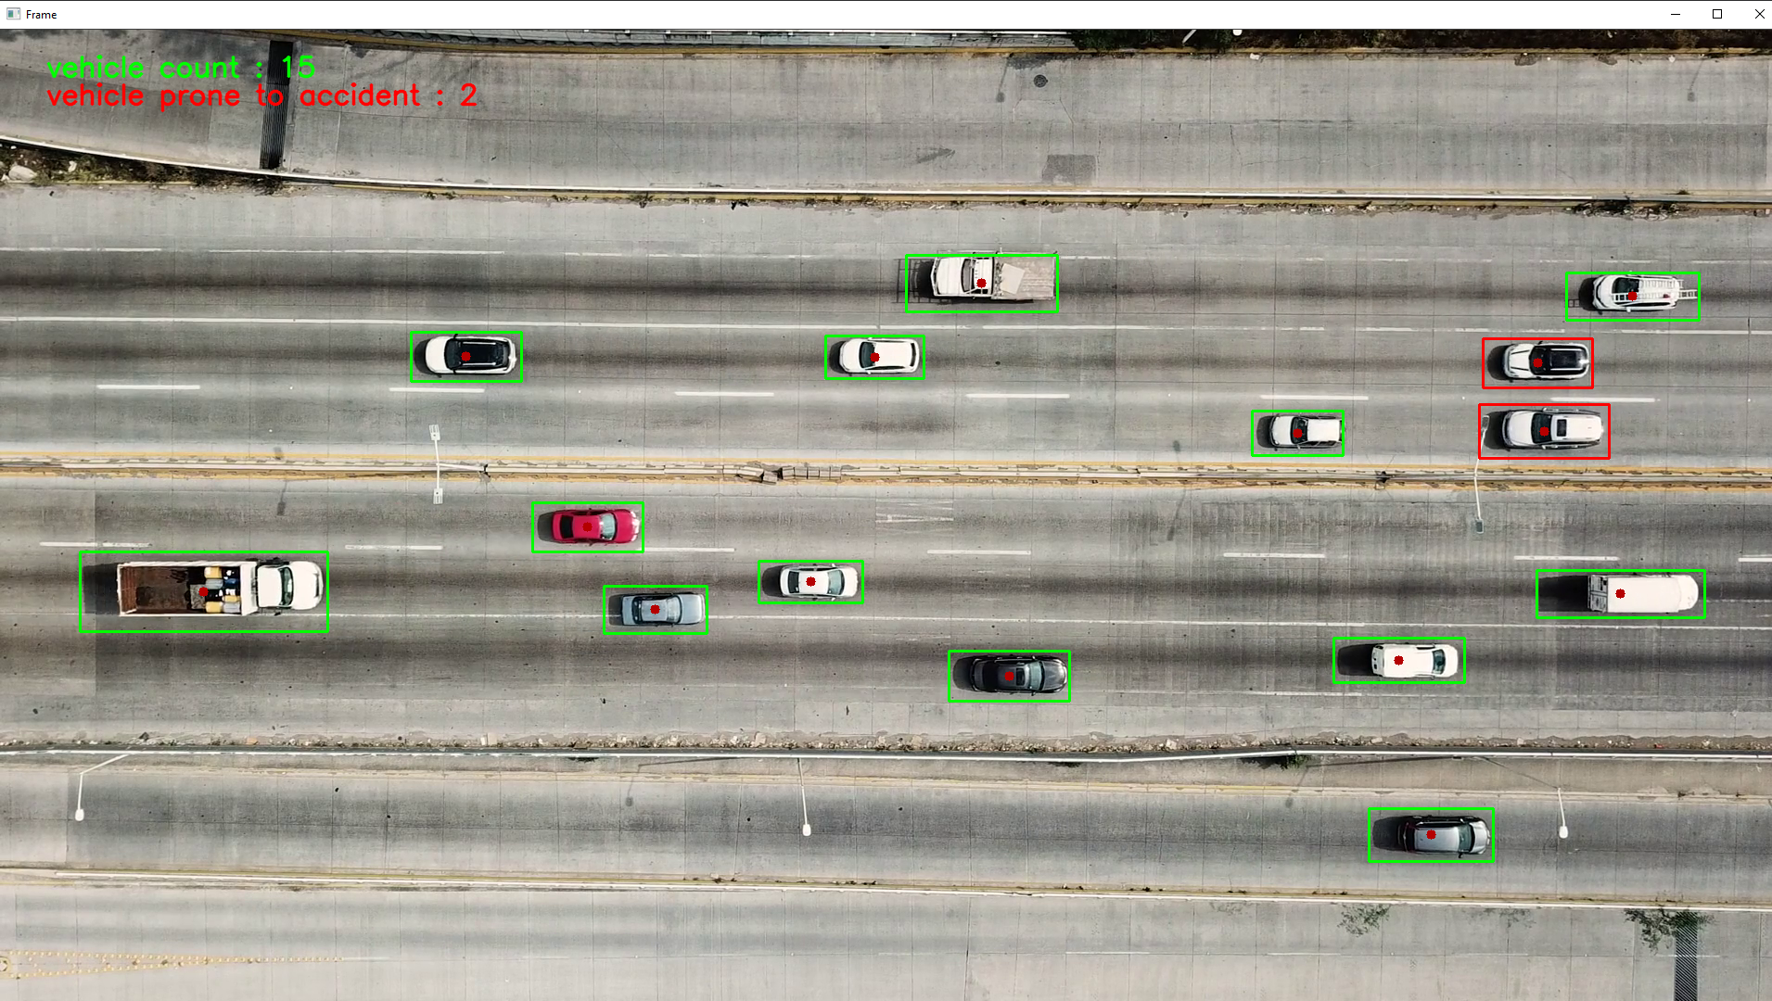
Accident Detection
These Two Vehicles are prone to accident

Slide 13
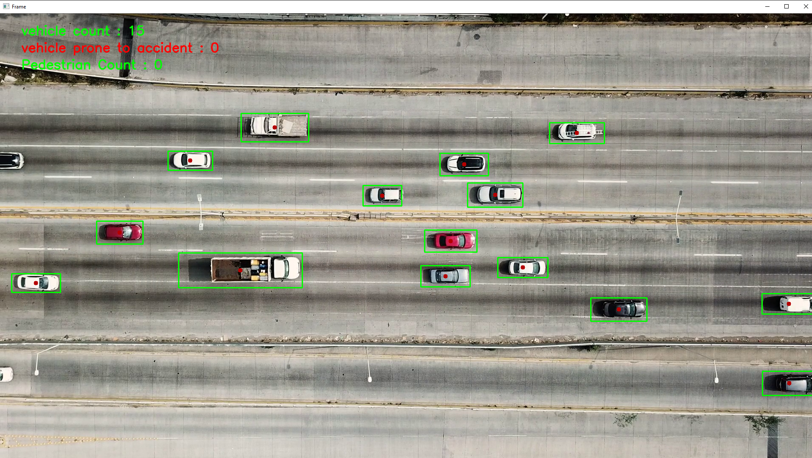
Pedestrian Count

Slide 14
THANK YOU

